Slide 1

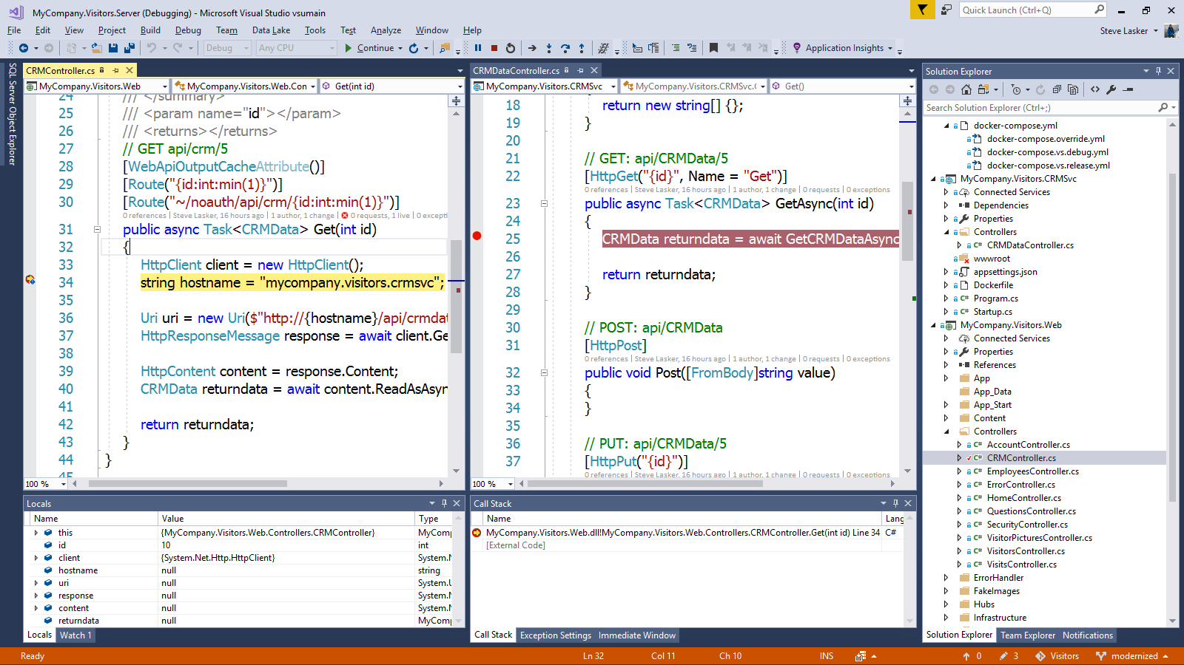
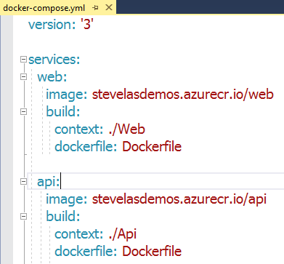
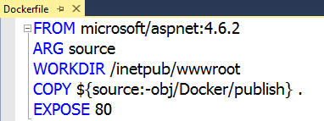
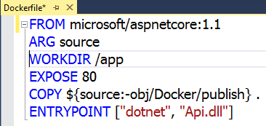
Visual Studio Container Tools
Run, Debug, Test Web & Console apps in docker containers
.NET FX w/Windows Server, .NET Core with Nano Server and Linux
Breakpoint Debugging
Edit & Refresh of code
Scaffolds docker assets
Dockerfile, docker-compose.yml

Slide 2

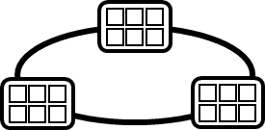

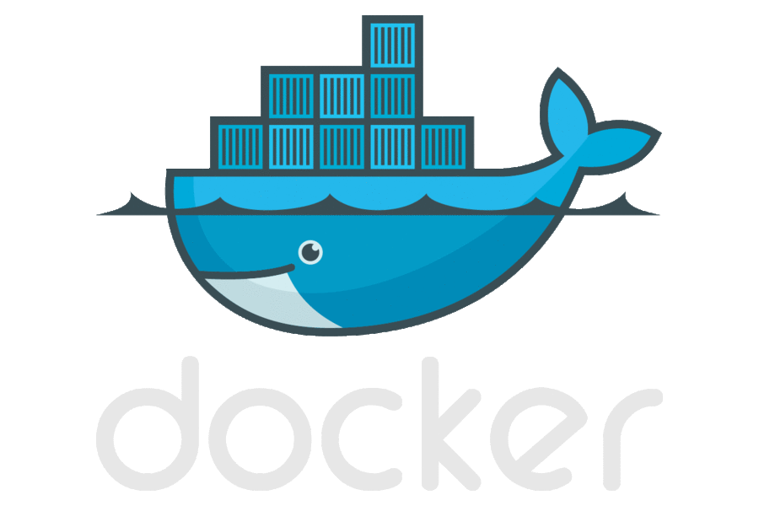




Containerized Workflow
Visual Studio Team Services
Container Service
2.
3.
4.
5.
Run, Manage
Service Fabric
Source Code Control
(SCC)
Build/CI,
Integrate,
Test
CD, Deploy
App Services
Production
environments
Common soon
Azure Container Registry
…
Push
Code
…
Inner-Loop
6.
…
1.
Run
Code
Validate
Outer-Loop
Debug
Notes:
When we look at the container continuous worfklows, we see containers and registries are a key concept.
We start with what we call the inner loop. Which is everything you do before you commit code.
From the beginning of your development cycle, you’re building and running your code in containers.
We pull base images from a container registry. Either Docker Hub, or perhaps our private corporate registry.
As we’re happy with our code, we commit the code to a source code repository.
The build system takes our code, a dockerfile that describes the build system and builds the collection of images I need for deployment
The images are pushed to our private registry, with the environment configurations extracted from the image.
When deployment happens, we pull images, add the environment information and push it out to various environments.
In Azure, we have many different container hosting offerings.
From Azure Container Service, which hosts the best of breed open source orchestrators
To Service Fabric, which can host guest containers
Or, Azure Batch, App Services for single container workloads that can scale.
And Azure continues to expand it’s container hosts as containers are becoming the unit of deployment.

Slide 3


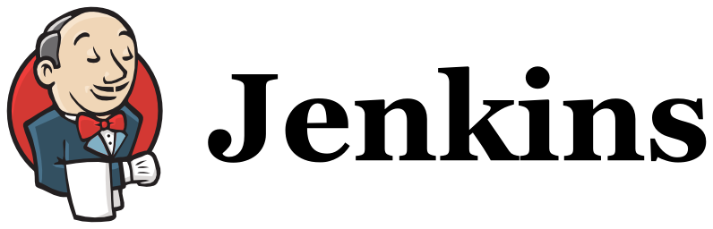
Language/ Framework
.NET
.NET Core
Node.js
GO
Java
Full FX
Core
Dev Tools
VS Code
IntelliJ
Build System
VSTS CI/CD
Target OS
Windows Server
Containers
Nano Server
Containers
Linux
Containers
Container Registry
Azure Container Registry
Secret Management
VSTS
Azure KeyVault, Hasicorp Valut
Container Hosting
App Services w/Containers
Service Fabric Guest Containers
ACS – Kubernetes
ACS – Docker
ACS –DC/OS

